Slide 1
Counters & Time Delays
COUNTERS - Are used to keep track of events.
TIME DELAYS -Accurate timing between two events.

Slide 2
COUNTERS
Initialize
A Counter is designed simply
by loading an appropriate
Display
number into one of the
registers and using the INR
Update
(Increment by one) or the
one)
is the
DCR (Decrement by
loop
No
Is this Final Count?
Yes
instructions. A established to
update
count, and each
count is
checked to determine whether
it has reached the final
Flowchart of a Counter
number; if not, the loop is repeated.

Slide 3
TIME DELAYS
The procedure used to design a specific delay is similar to that used to set up a counter.
A register is loaded with a number, depending on the time delay required, and then the register is decremented until it reaches zero by setting up a loop with a conditional jump instruction.
The loop causes the delay, depending upon the clock period of the system.
Load Delay Register
Body of loop
Is this Final Count?
No
Yes
Flowchart of a Time Delay

Slide 4
Calculating Time Delays
Each instruction combinations of
passes through different Opcode Fetch, Memory Read,
and Memory Write cycles.
Knowing the combinations of cycles, one can calculate how long such an instruction would require to complete.
Number of Bytes
Number of Machine Cycles
Number of T-State.

Slide 5
Calculating Time Delays
Time Delay = No. of T-States * Clock Period
For example,
“MVI” instruction uses 7 T-States.
Therefore, if the Microprocessor is running at 2 MHz, the instruction would require 3.5 μS to complete.
7X(1/(2X10⁶))=3.5 µsec

Slide 6
Time Delay using following three Techniques:
Using One Register.
Using a Register Pair.
Using a Loop with in a Loop

Slide 7
Using One Register
A count is loaded in a register, and loop can be used to produce a certain amount of time delay in a program.
The following is an example of a delay using One Register:
 | MVI C, FFH | 7 T-States
LOOP | DCR C | 4 T-States
 | JNZ LOOP | 10 T-States
The first instruction initializes the loop counter and is executed only
once requiring only 7 T-States.
The following two instructions form a loop that requires 14 T-States to execute and is repeated 255 times until C becomes 0.

Slide 8
Using One Register
We need to keep in mind though that in the last iteration of the loop, the JNZ instruction will fail and require only 7 T-States rather than the 10.
Therefore, we must deduct 3 T-States from the total delay to get an accurate delay calculation.
To calculate the delay, we use the following formula:
^{T}delay ^{= T}O ^{+ T}L
T_{delay} = total delay
T_{O} = delay outside the loop T_{L} = delay of the loop
T_{O} is the sum of all delays outside the loop.
T_{L} is calculated using the formula
T_{L} = T * Loop T-States * N (no. of iterations)

Slide 9
Using One Register
Using these formulas, we can calculate the time delay for the previous example:
T_{O} = 7 T-States
(Delay of the MVI instruction)
T_{L} = (14 X 255) - 3 = 3567 T-States
(14 T-States for the 2 instructions repeated 255 times (FF₁₆ = 255₁₀) reduced by the 3 T-States for the final JNZ.)
✓
^{T}delay
= [(T_{O} + T_{L} )/f]
= (7 + 3567)/2MHz
= (3574) X 0.5 Sec
= 1.787 mSec
(Assuming f = 2 MHz)

Slide 10
Using a Register Pair
Using a single register, one can repeat a loop for a maximum count of 255 times.
It is possible to increase this count by using a register pair for the loop counter instead of the single register.
A minor problem arises in how to test for the final count since DCX and INX do not modify the flags.
However, if the loop is looking for when the count becomes zero, we can use a small trick by ORing the two registers in the pair and then checking the zero flag.

Slide 11
Using a Register Pair
The following is an example of a delay loop set up with a register pair as the loop counter.
LXI B, 1000H DCX B
MOV A, C ORA B JNZ LOOP
10 T-States
6 T-States
4 T-States
4 T-States
10 T-States
LOOP

Slide 12
Using a Register Pair
Using the same formula from before, we can calculate:
T_{O} = 10 T-States
(The delay for the LXI instruction)
T_{L} = (24 X 4096) - 3 = 98301 T- States
(24 T-States for the 4 instructions in the loop repeated 4096 times (1000₁₆ = 4096₁₀) reduced by the 3 T-States for the JNZ in the last iteration.)
T_{Delay} = (10 + 98301) X 0.5 mSec = 49.155 mSec

Slide 13
Using a Loop with in a Loop
Initialize loop 2
Body of loop 2
Nested loops can be
Initialize loop 1
easily setup in
Body of loop 1
Assembly language by
using two registers for the two loop counters and updating the right register in the right loop.
Update the count1
No
Is this Final Count?
Yes
Update the count 2
No
Is this Final Count?
Yes
Flowchart for time delay with two loops

Slide 14
Using a Loop with in a Loop
Instead (or in conjunction with) Register Pairs, a nested loop structure can be used to increase the total delay produced.
 | MVI B, 10H | 7 T-States
LOOP2 | MVI C, FFH | 7 T-States
LOOP1 | DCR C | 4 T-States
 | JNZ LOOP1 | 10 T-States
 | DCR B | 4 T-States
 | JNZ LOOP2 | 10 T-States

Slide 15
Using a Loop with in a Loop
The calculation remains the same except that the formula must be applied recursively to each loop.
Start with the inner loop, then plug that delay in the calculation of the outer loop.
Delay of inner loop,
T_{O1} = 7 T-States
(MVI C, FFH instruction)
T_{L1} = (255 X 14) - 3 = 3567 T-States
(14 T-States for the DCR C and JNZ instructions repeated 255 times (FF₁₆ = 255₁₀) minus 3 for the final JNZ.)
T_{LOOP1} = 7 + 3567 = 3574 T-States

Slide 16
Using a Loop with in a Loop
Delay of outer loop
T_{O2} = 7 T-States
(MVI B, 10H instruction)
T_{L1} = (16 X (14 + 3574)) - 3 = 57405 T-States
(14 T-States for the DCR B and JNZ instructions and 3574
T-States for loop1 repeated 16 times (10₁₆ = 16₁₀) minus 3 for the final JNZ.)
T_{Delay} = 7 + 57405 = 57412 T-States
Total Delay
T_{Delay} = 57412 X 0.5 μSec = 28.706 mSec

Slide 17
Increasing the Time Delay
The Delay can be further increased by using register pairs for each of the loop counters in the nested loops setup.
It can also be increased by adding dummy instructions (like NOP) in the body of the loop.

Slide 18
Counter Design with Time Delay
Initialize Counter
Load Delay Register
Display
Body of loop
Time Delay
Update Count
Is this Final Count?
Is Count
Complete?
No
No
Yes
Yes

Slide 19
Initialize Counter
Initialize Counter
Display Count
Display
Update Count
Time Delay
Is
Count
Complete?
No
Yes
Update Count
Is
No Count Complete?
Time Delay
Go back
Yes
End
End
Variations Of Counter Flowchart

Slide 20
Hexadecimal counter
W r it e a p r o g r a m t o co u n t con tinuously
in hexa decimal from FF h to 00 h in a
System w it h a 0 . 5 m icro sec clock period. Use register c to set up a o ne
M illisecond delay between each count and display the numbers a t o ne o f the output ports.

Slide 21
Hexadecimal counter
This problem has two parts; the first is to set up a continuous down-counter, and the second is to design a given delay between two counts.
The hexadecimal counter is set up by loading a register with an appropriate starting number and decrementing it until it becomes zero. After zero count, the register goes back to FF because decrementing zero results in a (-1), which is FF in 2’s complement.
The 1 ms delay between each count is set up by using delay techniques.

Slide 22
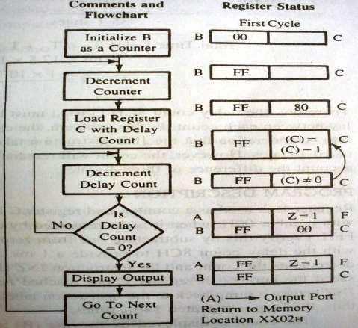
Hexadecimal counter
2000MVI B,00H
02 DCR B
2003 CALL 2060/DELAY
20:
2006 MOV A,B
2007 OUT PORT# 2009 JMP 2002
2060 MVI C 10
2062 DCR C
2063 JNZ 2062
2066 RET

Slide 23
Time Delay Calculation
Delay loop includes two instructions: DCR C and JNZ with 14 T-states. Therefore the time delay T_{L} in the loop (without accounting for the fact that JNZ requires 7 T-States in the last cycle, because count will remain same even if the calculations take into account the difference of 3 T-States) is:
T_{L} = 14 T-states X T (Clock period) X Count
= 14 X (0.5 x 10⁻⁶) x Count
= (7.0 X 10⁻⁶) X Count

Slide 24
The Delay outside the loop includes the following instructions:
DCR B
MVI C,COUNT MOV A,B
4T
7T
4T
Delay outside the loop:
T_{o} = 35 T-States * T
= 35 * (0.5* 10⁻⁶)
= 17.5 µs
OUT PORT JMP
10T
10T
35 T-States
Total Time Delay T_{D} = T_{o} + T_{L}
1ms= 17.5 * 10⁻⁶ + (7.0 *10⁻⁶) *Count
Count= 1x 10⁻³ – 17.5 x 10⁻⁶ ≈140_{10 ==1ms}
7.0 x 10⁻⁶
Hence, a delay count 8CH(140₁₀) must be loaded in C.

Slide 25
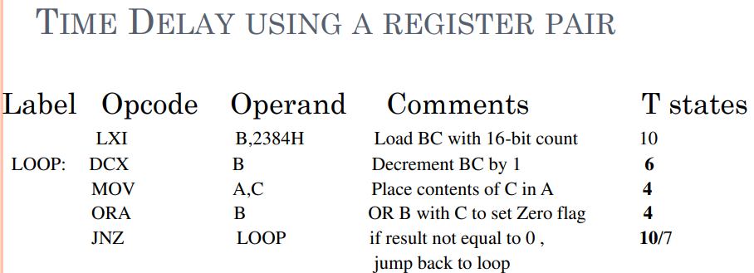

Slide 26


Slide 27
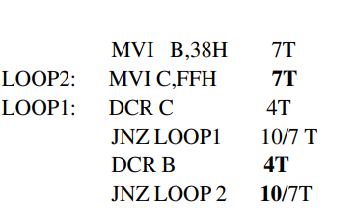

Slide 28


Slide 29
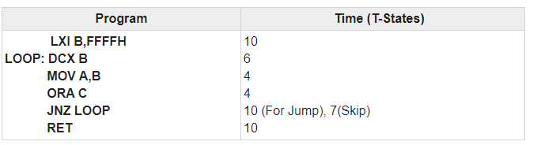
Using 16-bit register-pair as counter generate a delay of 0.5 second

Slide 30
10 + (6 + 4 + 4 + 10) * 65535H – 3 + 10 = 17 + 24 * 65535H = 1572857. So the time delay will be 1572857 * 1/3µs = 0.52428s. Here we are getting nearly 0.5s delay.

